Slide 1

Team Zero
Zero net energy housing
Levy Duivenvoorden Niels van Drunen Jefry el Bhwash Niels van Schaik Amin Mansouri

Slide 2
Today:
Project definition
Plots of last week
Messy Data
Plans for this week

Slide 3

Project definition
Predict the power usage and generation, one day in advance.
Create a model to use the prediction to yield a maximum amount of profit for the user using Factory Zero’s system.
Notes:
Afgelopen week was de defenitie van het project onduidelijk. Dit is de huidige definitie van ons project

Slide 4

Plots of Last week

Slide 5
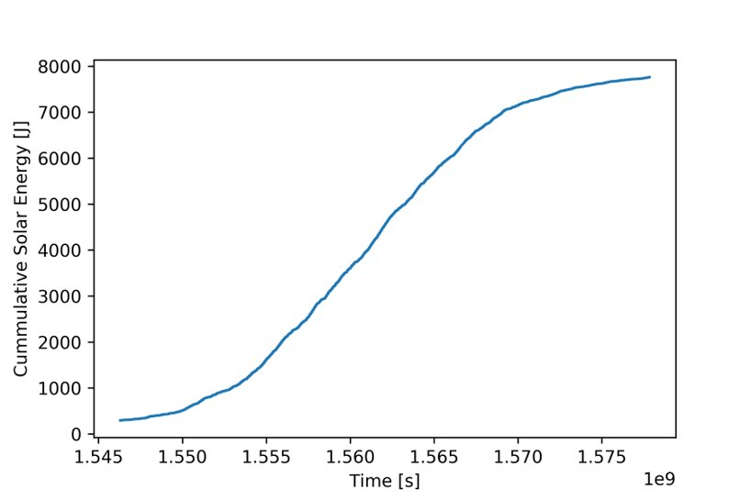
The solar energy of one of the houses

Slide 6
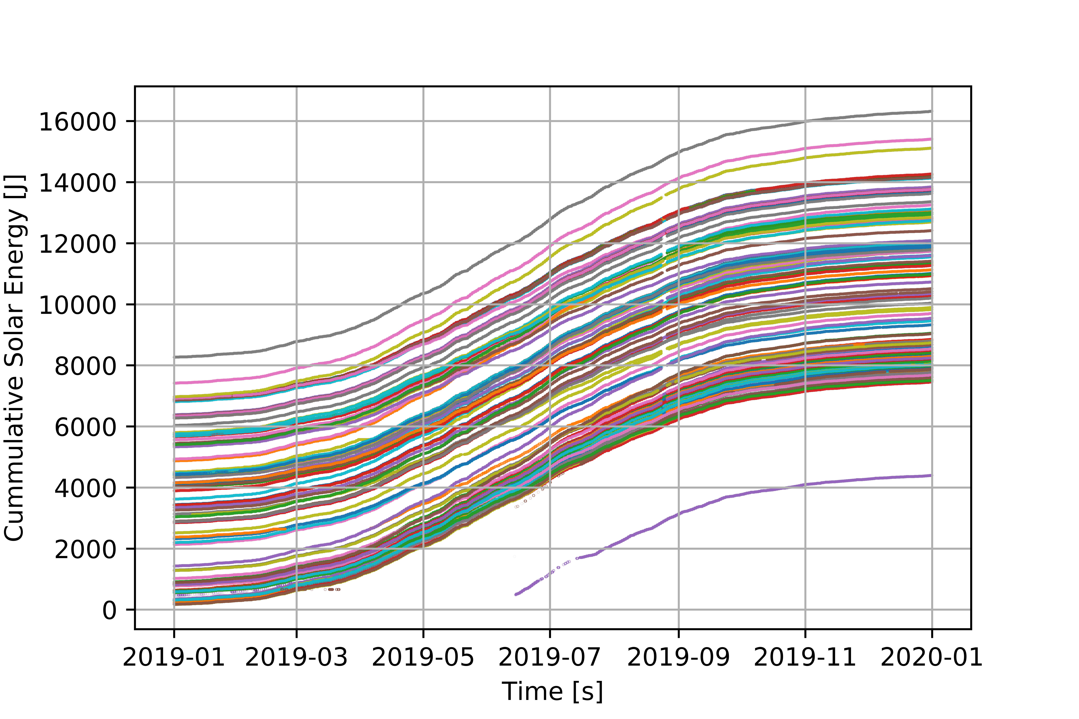
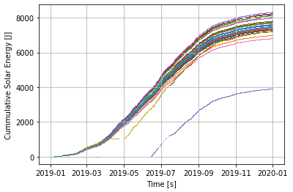
The solar energy of 120 houses

Slide 7

Messy Data
Data was checked in June
Data is in XLSX Format
Time to read 120 files is ~15 minutes
Conversion to 2-D NumPy arrays
Notes:
Conversie 2d array is onhandig door colom namen. Word kijken voor een betere oplossing

Slide 8

Plans for this week
Meetings
Datacamp
Read the report and replicate interesting graphs
Convert the Data to a more efficient format

Slide 9
Questions / Suggestions

